Slide 1
Machine Learning Hardware

Slide 2

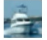
CIFAR10 vs MNIST: Load Datasets
28
32
28
32
Gray scale: 1 Channel
RGB: 3 Channels

Slide 3
FC and CNN fundamentals
Kernel size and weights
In channels and out channels
Y=XW+b

Slide 4
FC and CNN fundamentals
Kernel size and weights
In channels and out channels
Pool size

Slide 5
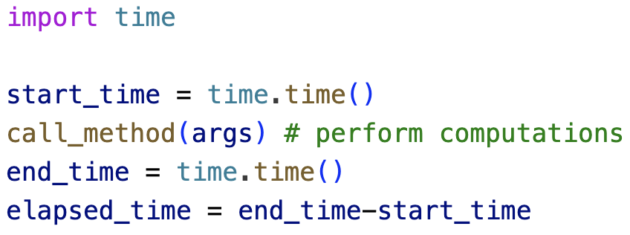
Estimating CoMptation Time
Python have a library called “Time”
time.time() will measure the current time

Slide 6
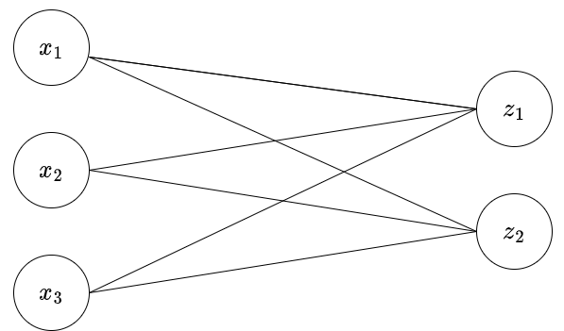
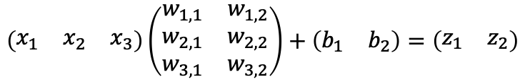
Estimating Analysis Metrics
$$\left(\begin{matrix}x_{1} & x_{2} & x_{3}\end{matrix}\right)\left(\begin{matrix}w_{1,1} & w_{1,2} \\ w_{2,1} & w_{2,2} \\ w_{3,1} & w_{3,2}\end{matrix}\right)+\left(\begin{matrix}b_{1} & b_{2}\end{matrix}\right)=\left(\begin{matrix}z_{1} & z_{2}\end{matrix}\right)$$
In channels and out channels vs number of kernels (filters)
Each element in the filter is a ‘weight’, hence, a parameter.
Trainable vs non-trainable:
It is trainable if it changes while training, non-trainable otherwise.
Total number of parameters is the total number of weights and biases. In this example:
Y=XW+b
Total number of 8 trainable parameters

